Slide 1
Decoding Fashion Feedback: Insights from Women’s Clothing Reviews
Leveraging Data for Better Product Recommendations
by Natallia Zimnitskaya
Presented as part of Capstone Project

Slide 2
About Me
My name is Natallia Zimnitskaya.
I am a medical doctor by training, but I have always been deeply interested in data analytics.
My passion for analyzing data comes from personal experience. My husband and I run an e-commerce business on the Amazon platform, giving me firsthand insights into the challenges of increasing sales in a competitive environment.
I know how difficult it can be to find the right niche and achieve success in the e-commerce landscape.
This personal connection is why I explored women’s clothing products for my Capstone Project.

Slide 3
The Problem and Our Goal
Problem: In a competitive e-commerce environment, businesses struggle to understand which products customers recommend and why. For example, businesses want to know why some products stand out in customer reviews while others struggle to gain traction.
Goal: Use customer data to create actionable insights that enhance recommendations, drive sales, and boost customer satisfaction.
Hypothesis:
Null: Customer data, like ratings or demographics, doesn’t significantly impact predicting product recommendations.
Alternative: Features such as ratings, helpful feedback, and customer demographics are important in predicting which products are likely to be recommended.

Slide 4
About the Dataset
Dataset: “Amazon Reviews on Women Dresses” sourced from Kaggle (Amazon Reviews on Women Dresses (23K Datapoints), 2022).
Scope:
Customer demographics: Age
Product Information: Division name, department name, class name
Feedback metrics: Rating, alike_feedback_count (helpful votes on reviews)
Recommendation: whether the product was recommended or not
These variables were analyzed to uncover patterns in customer behavior and product recommendations.

Slide 5
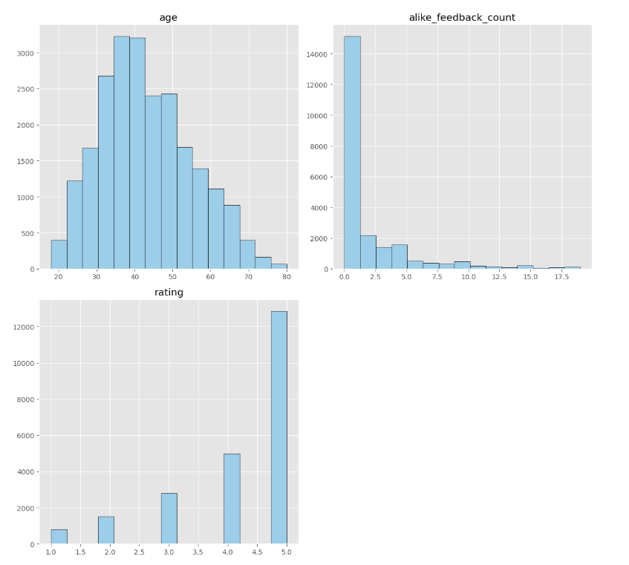
Key Variables Visualization
A chart of customer ages shows that most shoppers are between 30 and 40 years old, making this the key age group.
A chart of feedback votes shows that while most reviews only received a small number of helpful votes, a few stood out with as many as 19 votes.
A rating chart highlights that most customers rated products around 4.5, showing high satisfaction overall.

Slide 6
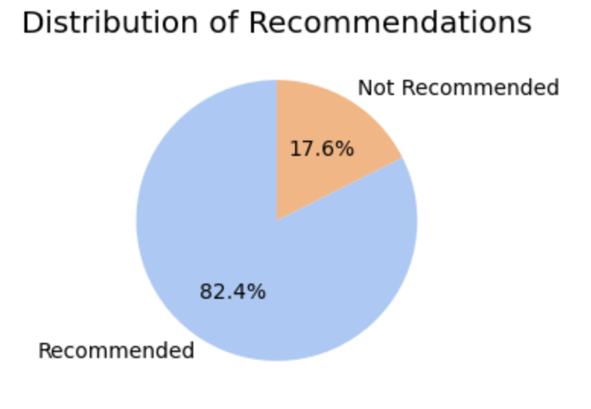
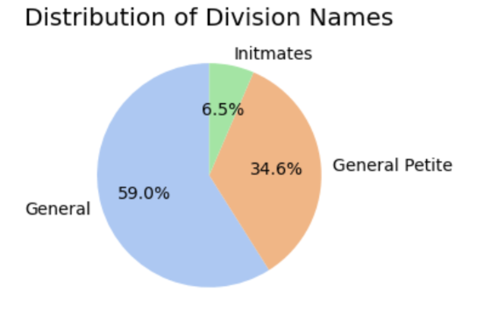
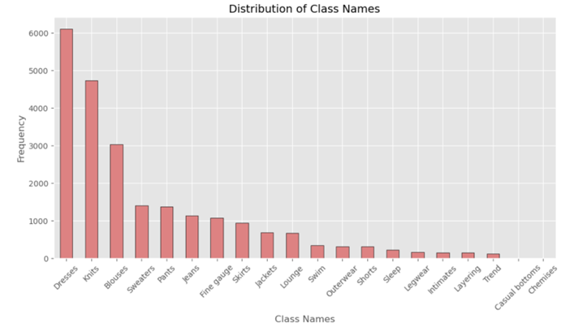
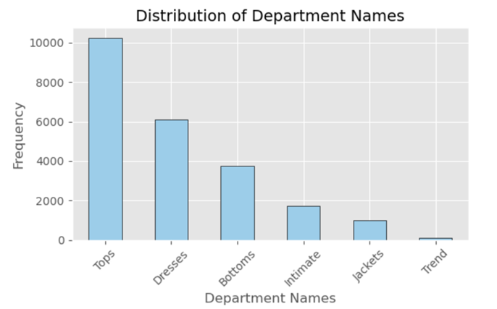
Key Variables Visualization (cont.)
The data shows that 82.4% of products were recommended by customers, highlighting a strong overall positive experience.
Most sales came from the General division (59%), followed by General Petite (34.6%). This can help guide how businesses plan their marketing and inventory.
Tops and Dresses stood out as the most popular categories, making them central to marketing efforts and product planning.
Items like Dresses, Knits, and Blouses were key drivers of sales and positive customer feedback, showing their importance for business strategies.

Slide 7
How We Worked with the Data
Fixed missing information and removed unusual data points to clean up the dataset, ensuring accuracy in the analysis.
Focused on structured data, leaving out written reviews and titles to simplify the data.
Adjusted numbers like age and feedback counts so they could be used effectively in the analysis.
Identified the most important factors, such as customer ratings and feedback, that influence product recommendations.
KNN (k-Nearest Neighbors) compares a product’s data to similar products to predict whether it will be recommended. For example, if similar products with high ratings and positive feedback are often recommended, the model can predict that this product will also likely be recommended. The KNN model was fine-tuned to achieve high accuracy in these predictions.

Slide 8
Model Performance and Key Insights
The model was 93.79% accurate at predicting whether a product would be recommended.
It performed exceptionally well at distinguishing between recommended and not recommended products (measured by an AUC score of 0.97).
The results showed very few mistakes: only 88 products were incorrectly classified as recommended when they shouldn’t, and only 197 products that should have been recommended were missed. This high reliability reduces the risk of recommending poorly rated products and ensures more accurate customer-focused decisions.
The strongest factors driving recommendations were:
Ratings (how highly customers rated the product).
Helpful feedback votes (how many people found a review helpful).
Popular product types, such as jeans, lounge, and sweaters.

Slide 9
Challenges and Limitations
The KNN tool requires the data to be cleaned and adjusted beforehand, which takes time and effort. This can also make it slower when working with large amounts of data.
The data used for this project is static, meaning it’s like a snapshot in time—it doesn’t account for recent customer trends or changes in preferences.
Since the study didn’t analyze written customer reviews, it missed out on uncovering deeper insights from what customers say about products.

Slide 10
Recommendations for Businesses
Businesses can make smarter decisions to boost sales and customer satisfaction by focusing on the following recommendations:
Focus on products that have received high ratings and frequent recommendations. Customers love these items, so promoting them will likely boost sales and enhance customer satisfaction.
Tailor marketing campaigns to appeal to the most active customers aged 30–40. This group represents a significant portion of shoppers and can drive consistent revenue.
Prioritize categories like tops, dresses, knits, and sweaters in advertising and inventory management. These categories are the most sought-after by customers, making them crucial for maximizing sales.
Explore real-time data analysis and tools like natural language processing (NLP) to gain better insights from customer reviews. This can help understand customer preferences and trends more effectively.

Slide 11
Final Thoughts
This project demonstrated how data analytics, powered by the KNN model, can improve women’s clothing sector product recommendations.
We uncovered actionable insights, such as promoting high-rated products and tailoring marketing strategies to key demographics, which can drive customer satisfaction and sales.
Future steps include integrating real-time data and analyzing textual reviews using advanced techniques like NLP for deeper customer insights.
These insights empower businesses to adapt quickly to customer needs, make smarter decisions, and remain competitive in a dynamic market.
Thank you for the opportunity to contribute meaningfully to improving e-commerce strategies and customer experiences.

Slide 12
Sources:
Amazon reviews on Women dresses (23K Datapoints). (2022, June 14). Kaggle. https://www.kaggle.com/datasets/surajjha101/myntra-reviews-on-women-dresses-comprehensive/data
Panopto Presentation

